Slide 1
IMM Graduate School
Marketing Friday Session
Digital Marketing - Strategy or Tactic

Slide 2

Who am I?
Wendy Monkley “She”EO - Digital Content Lab
30+ years in Marketing (MBA)
Agency + Client-Side experience
Good old bad days – No Digital Channels (WT?)
10 years ago, I pivoted my skills
How did I do it?
Started DC Lab almost 3 years ago
Outsourced partner to in-house marketing teams
  Content creation (video, social content, infographics, emailers etc)
  Direct marketing (campaign set-up, tracking and optimisation)
Part-time academic
  Online course development
  Lecturing and tutoring

Slide 3

Are you forever juggling balls?
Explosion of digital and social media marketing.
How often do you hear:
  “Digital marketing is critical to the
  future success of your businesses”?
This includes:
  SEO.
  Paid Ads.
  Content.
  Social Media.
  Automated Inbound.
  Bla, Bla, Bla.
And you the marketer must keep your existing digital and social marketing going …
PLUS, constantly add new stuff.
Search Engine Optimisation

Slide 4

So, what do you do?
How do you deal with this unrelenting pressure to adopt every new digital opportunity?
How do you keep abreast of every new social trend?
How do you shake the feeling of severe FOMO, or the fear that you are getting left behind.
Maybe take a step back.
Fear of Missing Out

Slide 5

Let’s first understand where digital fits in
Is it a strategy?
Is it a tactic?
Is it marketing?
Or is it promotion?
Even before the IoT, business owners and marketers were guilty of confusing marketing with advertising.
But let’s be clear…
Marketing and advertising
are not the same thing!
Internet of Things

Slide 6

Digital marketing has blurred the lines even further
When thinking of social media marketing or digital marketing marketers are often thinking of communication - not marketing in the true sense of the word.
Digital marketing, is really just about communication, and communication (advertising), is just one component of marketing.

Slide 7
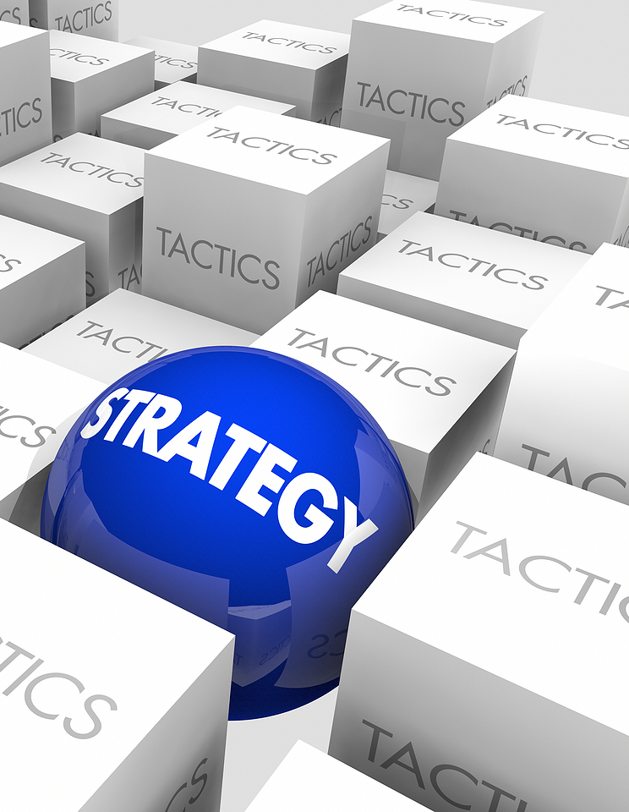
Marketing is much more than communication
It is about UNDERSTANDING
  Your market.
  Your category.
  Your customer.
  How your product or service is positioned.
  Your brand.
  Pricing.
  Distribution.
Marketing is the strategy that
ties everything together.

Slide 8
The marketing strategy must come first
Marketing first then determine which tactics or platforms are best suited and relevant for a particular brand and customer.
When you hear:
  Content strategy
  Facebook strategy
  Social Media Strategy
  ETC. ETC
These are all communication
platforms, tools and tactics.

Slide 9
Digital is important but not the only tool
Digital can in some cases be the largest component of your overall marketing mix.
But it needs to integrate with all other tools and tactics available.
And yes, each of these will require its own strategy and plan.
BUT, within the broader framework of your overarching marketing
strategy.
Digital marketing that is not supported by a strategy is just busy work.

Slide 10
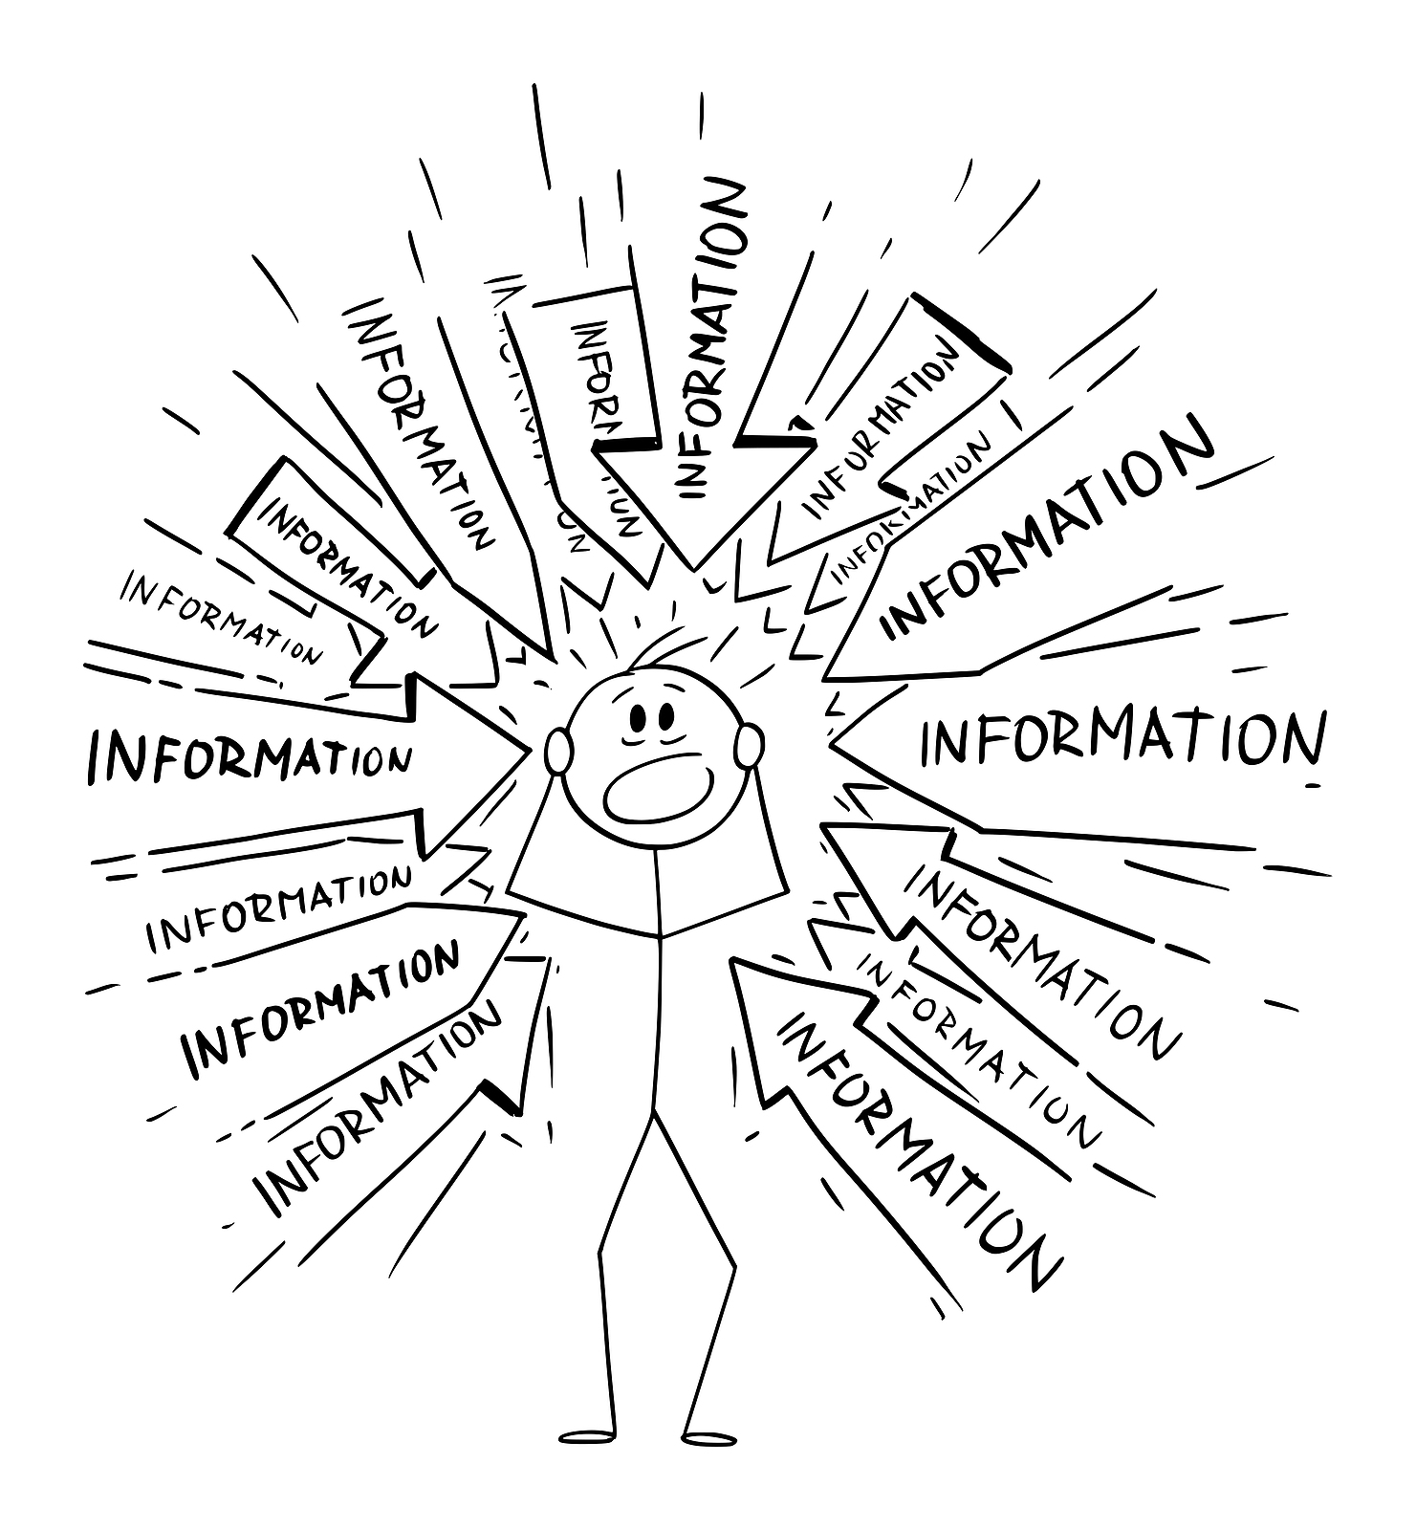
So, why the confusion?
Digital does extend past the communication mix into your marketing mix.
You need to distinguish between the two.
It could be your product (Netflix).
It could be your new way for distribution (Takealot).
In fact, digital technology has transformed the entire marketing mix.
All the more reason for a clearly defined marketing strategy.
The mix has been extended to include People, Processes, Physical Evidence
and Partnerships.

Slide 11
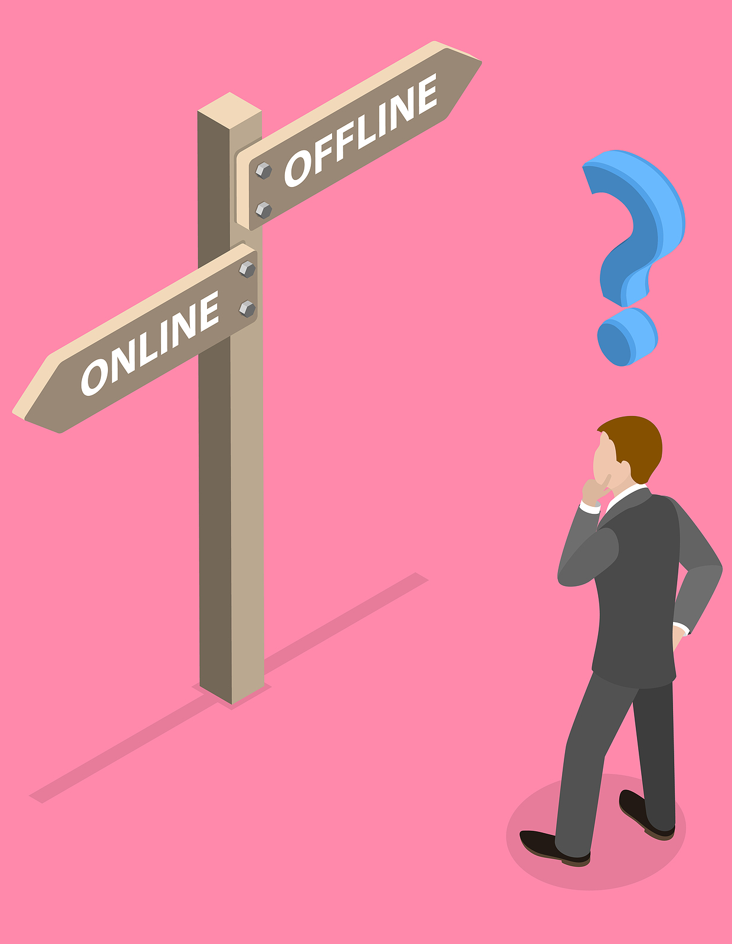
Self reflection time - have you developed a blind spot?
Traditional marketers are afraid of the new digital way, because they don’t (won’t) fully understand it.
New age marketers have developed a blind spot for traditional marketing because they think digital is the only way.
STOP sacrificing the one for the other – integrate!

Slide 12

And don’t only focus on sales
Bottom of the Funnel
BOFU clicks and conversions are the new drug of choice today.
Today’s trading climate is difficult, and businesses are very focused on sales.
But let’s not forget to focus on current, loyal customers.

Slide 13

First, ask yourself?
As a business owner or marketer, when last did you engage with your current customers, in a meaningful way?
When last did you ask them how your product/service is delivering and where you can improve, adapt, extend or innovate your offering?
Have you asked why your current customer buys your product?
What is your unique point of difference?

Slide 14
Let’s quickly recap
We are all juggling balls
Struggling to keep up
The marketing and communication concepts are still being blurred
We are very focused on sales
We have developed a blind spot
We don’t interact with our customers enough
We are possibly neglecting some communication channels that could benefit our businesses
We don’t have a marketing strategy that supports our digital communication
So, now what?

Slide 15
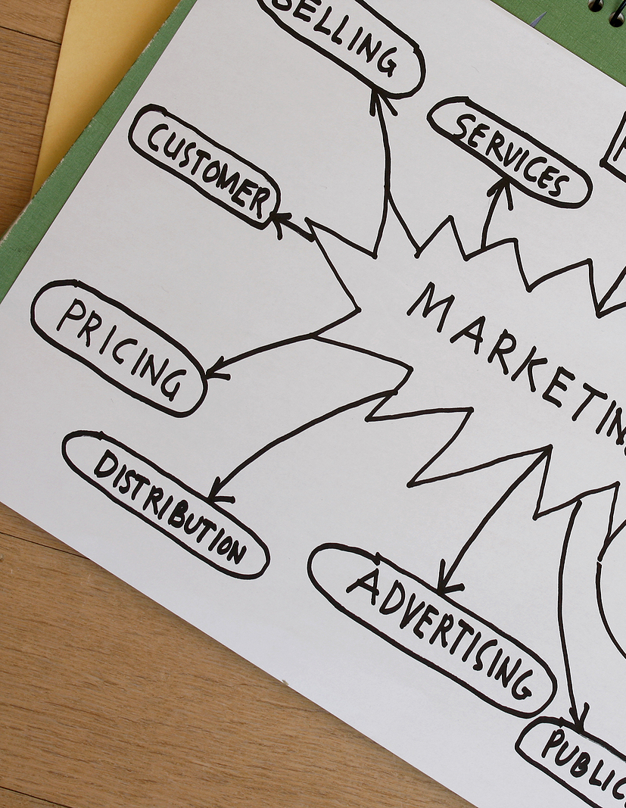
Good news! The tried and tested process has not changed
Research (Situation Analysis)
  Macro, Market, Micro
  Competition
  Customers
Key Issues
Primary Research
Key Insights
STP
Big Idea
Communication Objectives
Marketing Communications Mix Strategy
Budget
Implementation, Evaluation, Control

Slide 16

Where to start?
At the beginning.
It’s a cycle, always be learning, always be adapting.
Remember – Marketing strategy first.
Communication tools and tactics second.
Always integrate!

Slide 17
THANK YOU

